Slide 1
Is SOFIX immune? COVID-19 impact on Bulgarian Stock Exchange
Gergana Taneva, Stanimir Kabaivanov

Slide 2
Motivation
Why is this study necessary?
COVID-19 – though this term should be enough on its own, the pandemic has caused a lot of disruption on financial markets.
We believe that media hype should be thrown away and data should be presented in a reasonable and sound way.
Notes:
Exactly the case of very special underlying assets is at the core of this paper.

Slide 3
The [very] distinct case of SOFIX
What is so special about it:

Slide 4
What is so special about it (2)
Used data
Daily changes of SOFIX against daily changes in COVID-19 cases (right) and rate of increase decrease in cases (left)

Slide 5
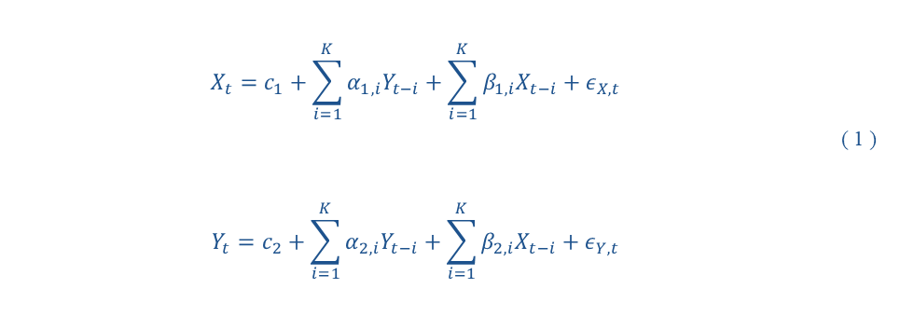
Very simple tools
Why use simple tools?
A simple Granger causality test with two variables – first of them related to COVID-19 impact and the second, representing changes in the stock market. Denoting them as X and Y, the test actually needs to determine if any of the X lags in equation ( 1 ) are statistically significant.
$$X_{t}=c_{1}+\sum_{i=1}^{K}{α_{1,i}Y_{t−i}}+\sum_{i=1}^{K}{β_{1,i}X_{t−i}}+ε_{X,t}$$ $$Y_{t}=c_{2}+\sum_{i=1}^{K}{α_{2,i}Y_{t−i}}+\sum_{i=1}^{K}{β_{2,i}X_{t−i}}+ε_{Y,t}$$ | ( 1 )

Slide 6
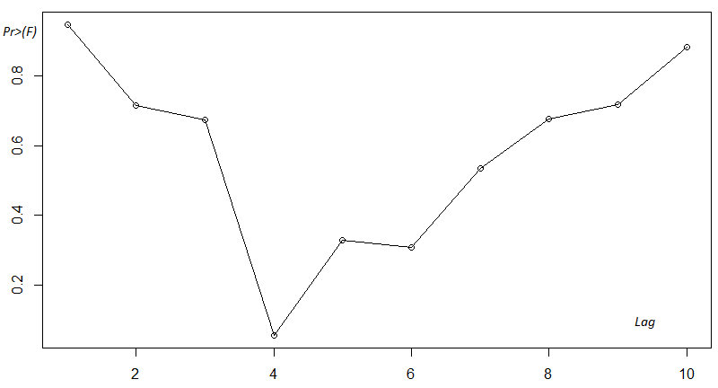
Simple results
Stationarity tests on used time series
Causality test with different lags
Table 2. Stationarity of time series
ADF Test (lag 13) | COVID-19 daily cases | SOFIX
 | unit-root null hypothesis, asymptotic p-value
Original time series (TS) | 0.09876 (with const) 0.2089 (with const and trend) | 0. 9352 (with const) 0.5116 (with const and trend)
First difference TS | 0.04644 (with const) 0.1365 (with const and trend) | 6.495e-012 (with const) 3.589e-011 (with const and trend)
Second difference TS | 1.554e-012 (with const) 8.335e-012 (with const and trend)
Входни данни на
НМ

Slide 7
Conclusions
Main conclusions
It is hard to find strong evidence that pandemic has had hefty immediate effects on local stock market and SOFIX index movements.
Further analysis suggests that there are several major factors that attribute to low and slow crisis influence – relatively low volumes of trade, longer time to feel the impact of the pandemic on the index constituents and quickly introduced initial flexibility in working schedules.
Входни данни на
НМ

Slide 8
In fine…
THANK YOU FOR YOUR ATTENTION!

